Slide 1

Bitcoin PRICE PREDICTION

Slide 2
SUMMARY
Bitcoin is a cryptocurrency and worldwide payment system. It is the first decentralized digital currency, as the system works without a central bank or single administrator. It can be used to buy merchandise anonymously.
Bitcoin is highly volatile and has higher returns than conventional financial trading.
History generally has a way of repeating itself but bitcoin has a lot of history which makes it an equal challenge predicting which history will be repeated. It takes more than a study of past trends to get predictions.
The goal of this project is to find a model where we can predict the value of the Bitcoin stock considering all the factors which influence the price.

Slide 3
GOAL
NEED TO DELETE THIS SLIDE
Bitcoin prices in 2018 have been marked by volatility which has made bitcoin price prediction a bit of a challenge. It has higher returns than conventional financial trading.
History generally has a way of repeating itself but bitcoin has a lot of history which makes it an equal challenge predicting which history will be repeated. It takes more than a study of past trends to get predictions spot-on this time and so we ended this article by highlighting certain area expert analysts were looking at.
Bitcoin is highly volatile which makes it very difficult to predict the stock price.
Bitcoin
Goal: To find a model where we can predict the value of the Bitcoin stock considering all the factors which influence the price.
Notes:
Add some more information on why you chose project, and specifically bitcoin.

Slide 4
FACTORS THAT INFLUENCE BITCOIN
Reddit Metrics: Looking at Reddit Metrics and coin prices
Google Trends: Looking at Google searches and coin prices.
Stock Market Prices: Looking at the stock market and coin prices
Commodity Prices: Looking at Bitcoin and the more traditional stores of value (gold)
Oil Prices: Looking at Bitcoin and the oil prices
Social Media : Looking at Bitcoin and the sentiment analysis

Slide 5
DATA COLLECTION
Collected data from the following sources:
Crypto Compare - Retrieved the historical price of one coin relative to another (currency pair) from poloniex
Bitcoin Price – Retrieved basic historical information for a specific cryptocurrency from coinmarketcap.com
Google Trends - Retrieved daily google trends data for a list of search terms
Twitter data - Retrieved the historical tweets related to Bitcoin (Twitter.com)
Stock Market Prices (finance.yahoo.com)
Commodity Prices - Retrieved the historical price of gold, silver, platinum and palladium
Oil Prices - Retrieved the historical oil price (London Brent crude)
Reddit Metrics - Retrieved daily subscriber data for a specific subreddit scraped from redditmetrics.com

Slide 6
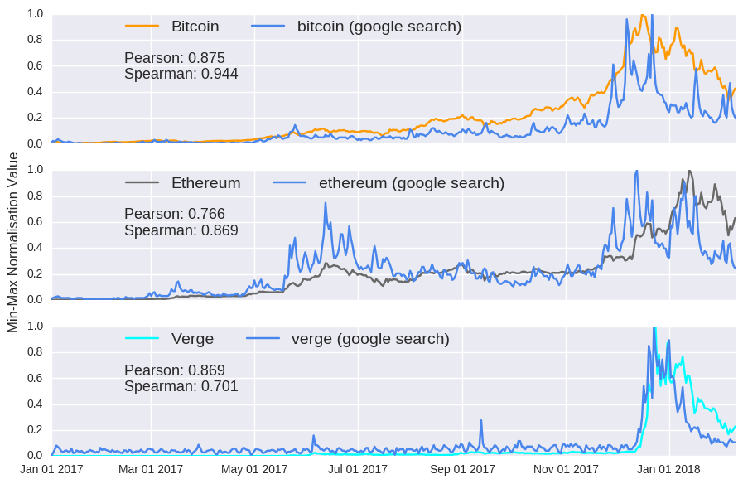
Correlation between google searches and coin prices

Slide 7
DATA PRE-PROCESSING
Reddit/Tweets
Tokenizing
Sentiment Analysis
Google Trends
Search Frequency
Merge
CoinDesk API
Bitcoin Price
Merge
Stock Market
Commodity
Oil
Stock Prices
Commodity Prices
Oil Prices
Merge
Feature Vector

Slide 8
PREDICTIVE ANALYSIS
Two types of models:
Traditional time-series ARIMA model
Deep Learning Model

Slide 9
ARIMA MODEL - PERFORMANCE
Autoregressive Integrated Moving Average – Time Series Model
With lag = 24
With difference order = 1 to make the series stationary
With moving average =1
Train/Test: 70/30
Steps | Exogeneous Variables | MSE
1 -100 | 6 | 0.000039
101-600 | 6 | 0.000918
Steps | Exogeneous Variables | MSE
1 -100 | 3 | 0.000036
101-600 | 3 | 0.000118

Slide 10
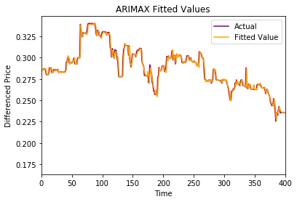
ARIMA MODEL GRAPH
ARIMA PLOTS & PERFORMANCE
Mean Squared Error : 0.000036

Slide 11
DEEP LEARNING MODEL - PERFORMANCE
Simple sequence to sequence to model
100 hidden dimension for Encoder and Decoder LSTM
KERAS and Tensor Flow
Adam Optimizer|100 Batchsize|300 epochs
Loss Function: Minimize Mean Squared Loss
RESULT
Input Sequence Length | RMSE
Lookback = 1 | 4.653
Lookback = 2 | 4.906
Lookback = 3 | 5.009

Slide 12
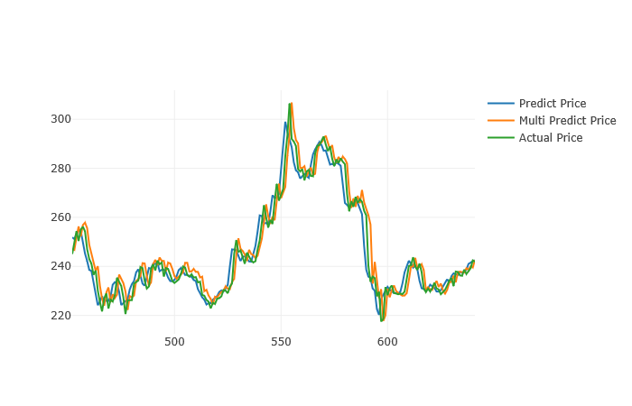
DEEP LEARNING MODEL
PREDICTION PLOTS

Slide 13
FUTURE ENHANCEMENTS
Develop an automated trading system with Buy/Sell notification
Alerts:-
Define Threshold
If Predicted Bitcoin Price is above threshold ----- ‘Buy’ signal
If Predicted Bitcoin Price is below threshold ----- ‘Sell’ signal
Alert System
SMS via Twillo
Email

Slide 14












Future Enhancement
Automated Trading System
Machine Learning Model
Data collection and pre-processing
Presentation
Bitcoin Price Chart
SMS/Email
Store results in a SQL database

